Slide 1
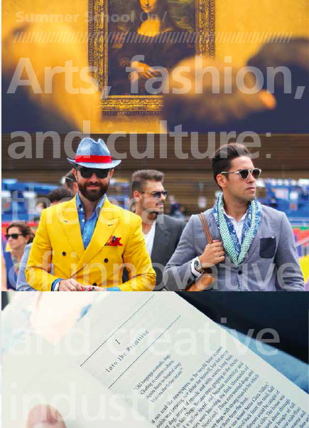




Summer School on
Arts, fashion, and culture
The era of innovative and creative industries
How to develop a winning Italy-China cooperation
In cooperation with:
In partnership with:

Slide 2
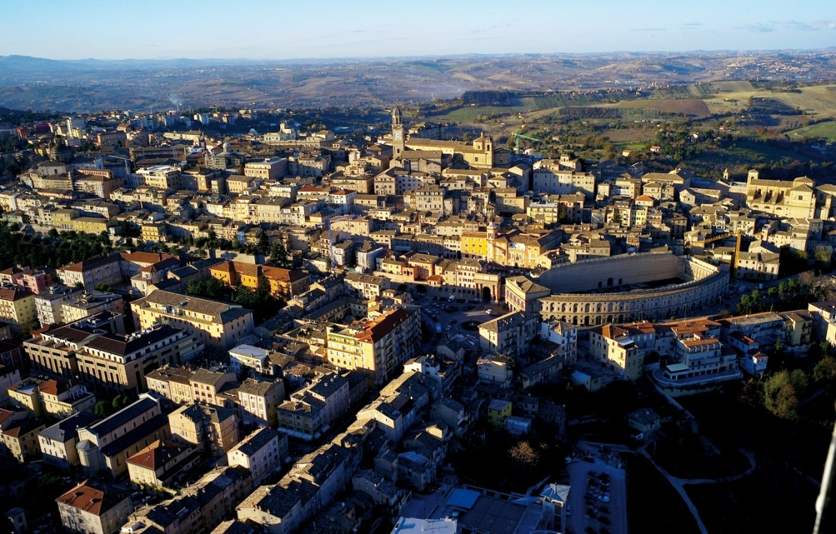
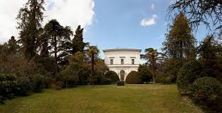
Where
City of Macerata
In the Marche Region, Italy
VILLA COLA
Confucius Institute of Macerata, University of Macerata

Slide 3
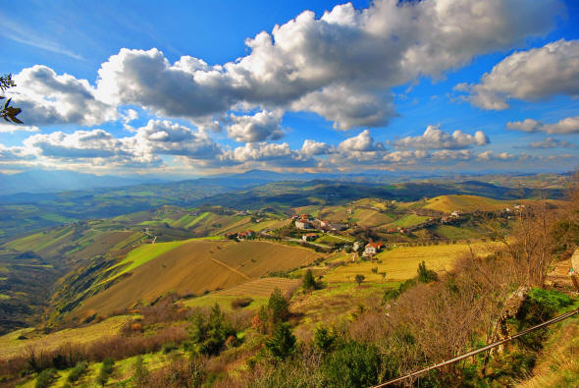
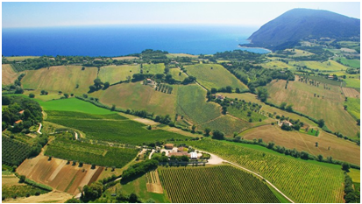
When: July 2016
Duration: 2 week from 11th to 22nd July
First week: thematic workshop by academics and speaches by professionals and experts
Second week: a focus on key industries (Food&wine, Tourism, Digital games and Fashion) with experts and field visits
At the beginning of the Summer Schools, participants will be grouped in 4-5 groups to develop Business ideas and innovation ideas to be presented at the end of the 2 weeks period. Every day, students will have time to discuss and interact to develop their ideas.

Slide 4
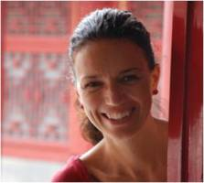
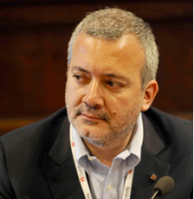
11th July, Session 1 - Creative and cultural Industries
Contents:
A general introduction to creativity and innovation. The role of cultural and creative industries.
Case study: the Casoli Foundation of Elica Group (with Debora Carrè) and Arnaldo Caprai of Cruciani group (with Marco Caprai)
Speakers:
Francesca Spigarelli
Assistant Professor of Economics, University of Macerata; Vice Rector for Entrepreneurship and Technological Transfer
Fabio Renzi
General secretary and promoter of Symbola, the Foundation for Italian Quality.

Slide 5
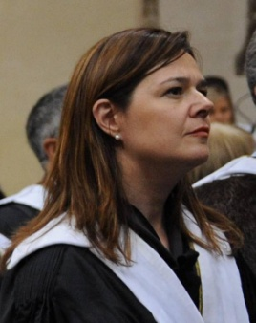
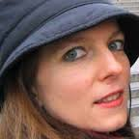
12th July, Session 2 - Culture and creativity: the levers of innovation
Contents:
Culture and creativity: It is not just a matter of birth.
Culture as core capital: What is “culture” in a multicultural age?
Strategies to develop creativity
From creativity to innovation: the case of iGuzzini
  Field visit at iGuzzini (www.iguzzini.com)
Speakers:
Carla Danani
Associate Professor of "Political Philosophy", "Philosophy of Dwelling" and "Philosophical Practices" at the University of Macerata
Ivana Bianchi
Associate professor of General Psychology at the University of Macerata, Department of Educational Sciences

Slide 6
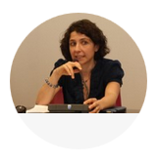
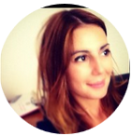
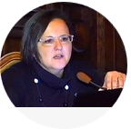
13 th July, Session 3 - Comunicating with creativity: press, web, performing arts
Contents:
Creativity and crossmedia: the case of performing arts
How Web Advertising Works: When and how to be creative; Creativity in Fashion advertising
Creativity in fashion: press release
Manage publishing and editorial projects
Speakers:
Lucia D’Ambrosi
Researcher in Sociology of cultural and communication processes. Vice Rector for institutional communication
Gianna Angelini
Associate professor in Semiotic. Vice Director of NoemaLab and professional consultant in communications and a strategical marketing
Paola Papakristo
Associate professor in Theory and Techniques of Advertising Communication, University of Macerata

Slide 7
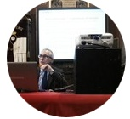
14th July, Session 4 - How to finance creative and cultural firms and activities
Contents:
Crowdfunding and web-based solutions to support financial needs of cultural and creative industries.
Case studies: Ginger platform and other relevant cases The enhancement of corporate identity, brand and know-how through corporate museums and archives
Speaker:
Alessandro Grasso
Associate professor in Economics of Banking, Financial Instruments and Financing of Company, University of Macerata

Slide 8
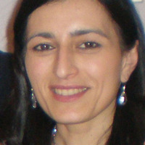
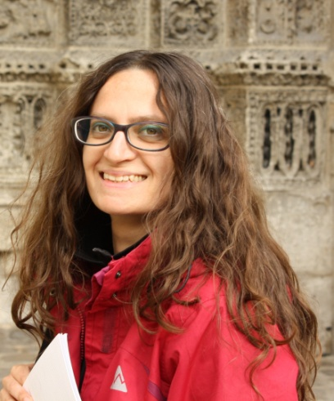
15th July, Session 5 - Cultural heritage, tourism, food and wine
Contents:
The marketing of cultural heritage and landscape: the role of museums
The management of museum networks and cultural districts for sustainable tourism development
Cultural heritage and art history in Italy: the case of the italian local museums as territorial promoters
Field visit of local Museums (Macerata, civic museums of Palazzo Buonaccorsi)
Speakers:
Francesca Coltrinari
Assistant professor in History of early modern art University of Macerata
Department of education, cultural heritage and tourism
Mara Cerquetti
Researcher in Management
University of Macerata
Department of education, cultural heritage and tourism

Slide 9
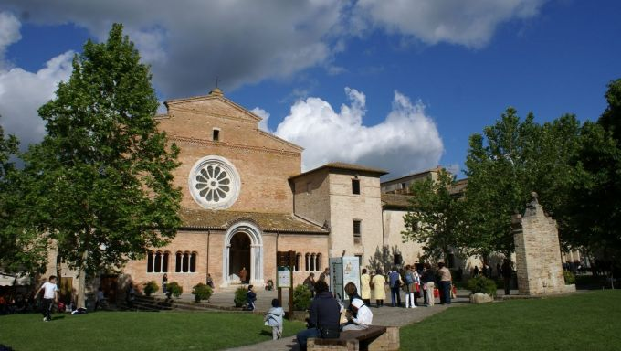
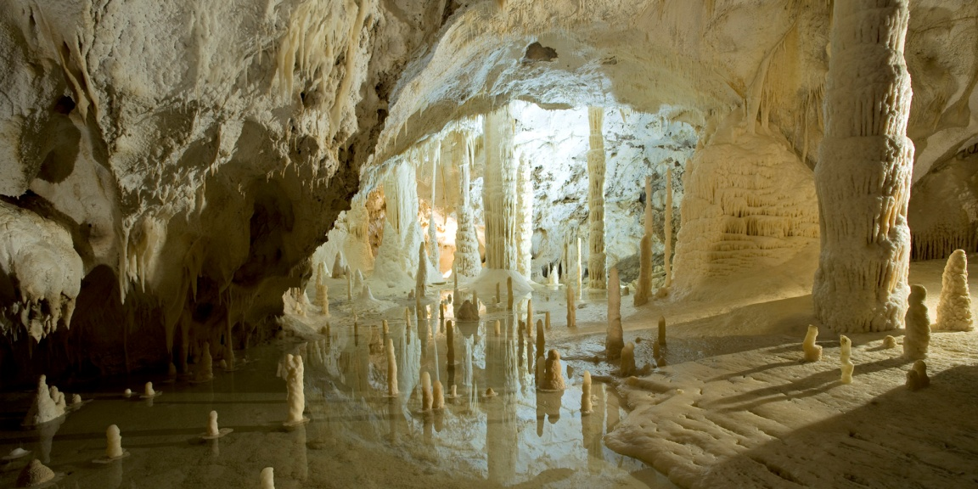
16-17 th July, Saturday and Sunday break – Cultural visits
ABADIA DI FIASTRA
FRASASSI CAVES

Slide 10
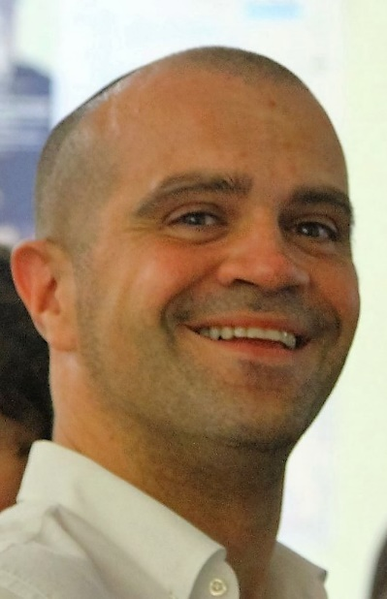
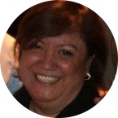
18-19th July, Cultural heritage, tourism, food and wine
Contents:
Food and Wine as luxury goods. The Mediterranean diet
Experiential learning. Tasting wine, learning from wine
Field visit of local wineries, local food producers.
Sleep in Agritourism and experience innovation through food and wine
Speakers:
Alessio Cavicchi
Associate professor University of Macerata
Department of education, cultural heritage and tourism
Lucia Bailetti
Italian Center for Sensory Analysis
Food engineer

Slide 11
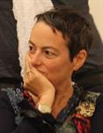
20 th July, Session 6 - Games, learning and entertainment
Contents:
Crativity in Games
Games for urban planning. The case of You place it!
Field visits:
Rainbow (http://www.rbw.it/en/)
Clementoni (http://www.clementoni.com/en/the-man-of-games/)
Speaker:
Paola Monachesi
Assistant Professor Utrecht Institute of linguistic
ots – language, logic and information departement of languages, litterature and communication

Slide 12
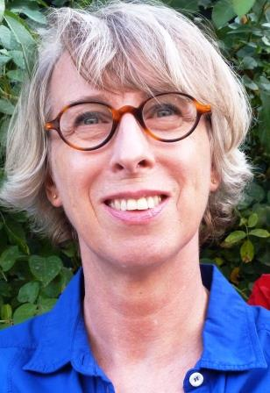
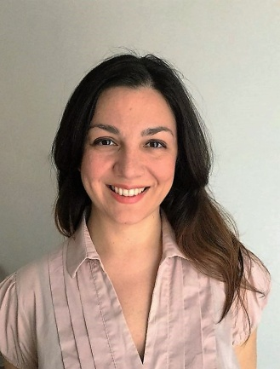
21 th July, Session 7 - Fashion, creativity and design
Contents:
a critical review of definitions of fashion as well as of the theoretical concepts and debates that have shaped the development of fashion and fashion studies as a scholarly field;
fashion as a commercial, creative and cultural industry
case study analysis: product innovation (Repetto, Uniqlo), internationalization (E. Zegna), distribution (Prada) communication (Louis Vuitton, Saint Laurent).
Speakers:
Anneke Smelik
Professor of Visual Culture on the Katrien van Munster chair at the Radboud University Nijmegen (Netherlands)
Stefania Masè
Ph.D. Management and Accounting & Commerce International et Europe Macerata University & Sorbonne University Paris

Slide 13

22th July, Discussions and interaction
Contents:
Discussion and presentation of Ideas from Participants
Ends of works

Slide 14
General Information
Please, visit
http://www.unimc.it/chinacenter/it/formazione-ed-eventi/summer-school
Scientific coordinator:
Prof. Francesca Spigarelli (francesca.spigarelli@unimc.it)
To apply for the summer school:
Dr. Claudia Mengoni (claudia.mengoni@unimc.it)

